Slide 1
Bike-Share Navigate Speedy Success
Case study of Google data analytics professional certificate programme offered by Coursera.
Author-Shubhankar Sharma

Slide 2
CONTEXT
*Cyclist, a company offers cycle rides in a city.
*Rides are of two types(Subscription)-Annual membership and Casual membership
*Single ride passes and full-day passes comes in CASUAL MEMBERS
*Un till now , Cyclist are campaigning for general awareness and attracted huge amount of subscribers . However , Management believes in maximizing annual members for future growth

Slide 3
Context continues..
*The management of the company believes in the conversion of maximum number of casual riders to annual members for a future growth .
*So The Business Task is to convert existing casual members to annual members after getting insights from data.
*Lets have some insights from the Data we got From jan-2021 to Dec-2021.

Slide 4
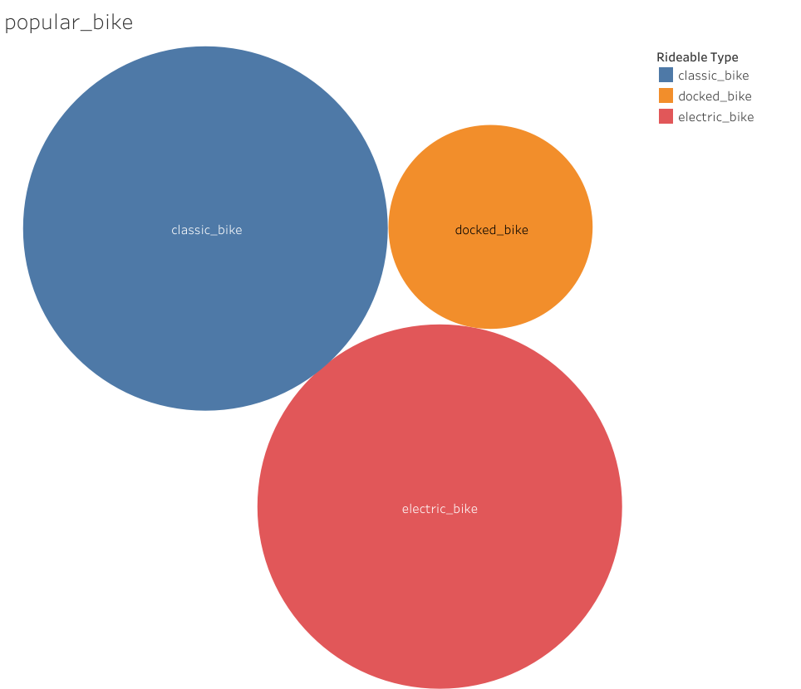
Popular bikes among casual members –FIG 1
*Casual members preferred to Ride almost equally on classic and electric bike and docked bike is less preferrable.

Slide 5
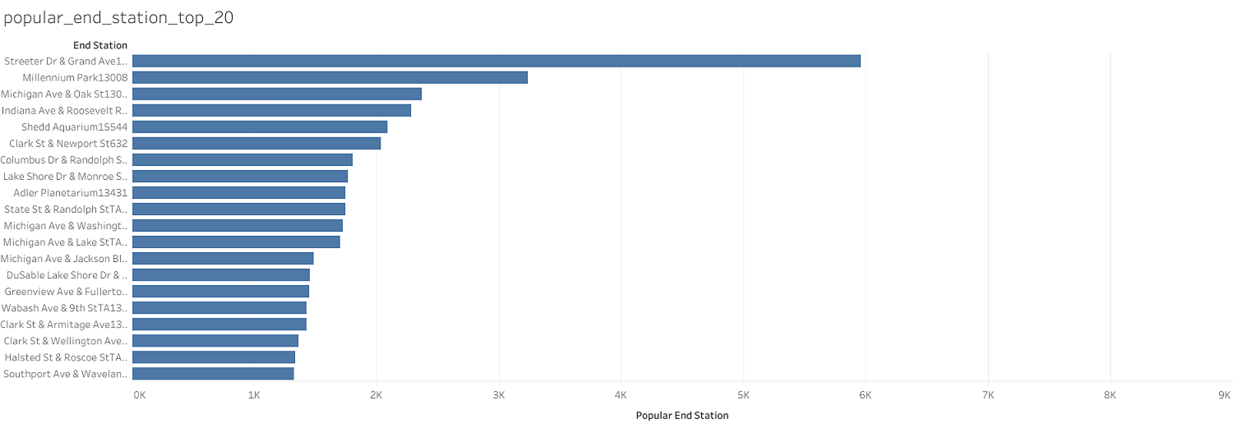
Top 20 Popular End stations –Fig 2

Slide 6
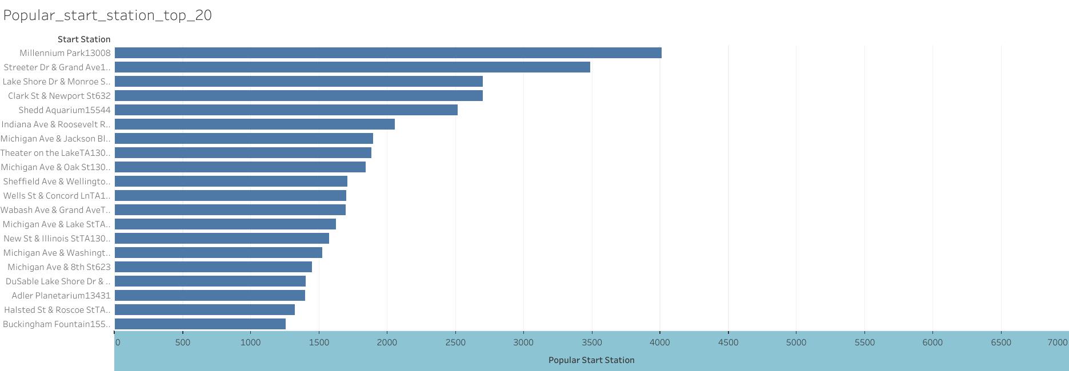
Top 20 Popular Start stations-Fig 3

Slide 7
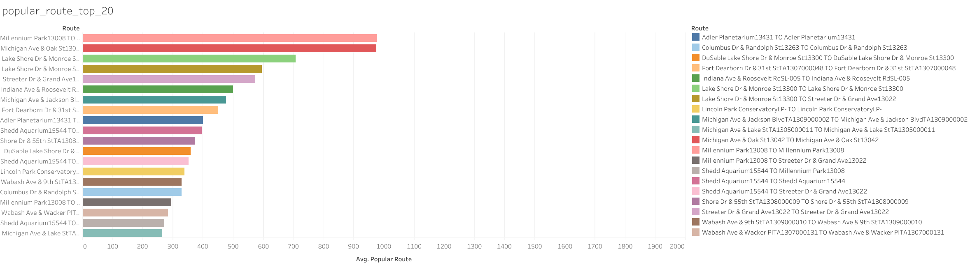
Top 20 Popular Route-Fig 4

Slide 8
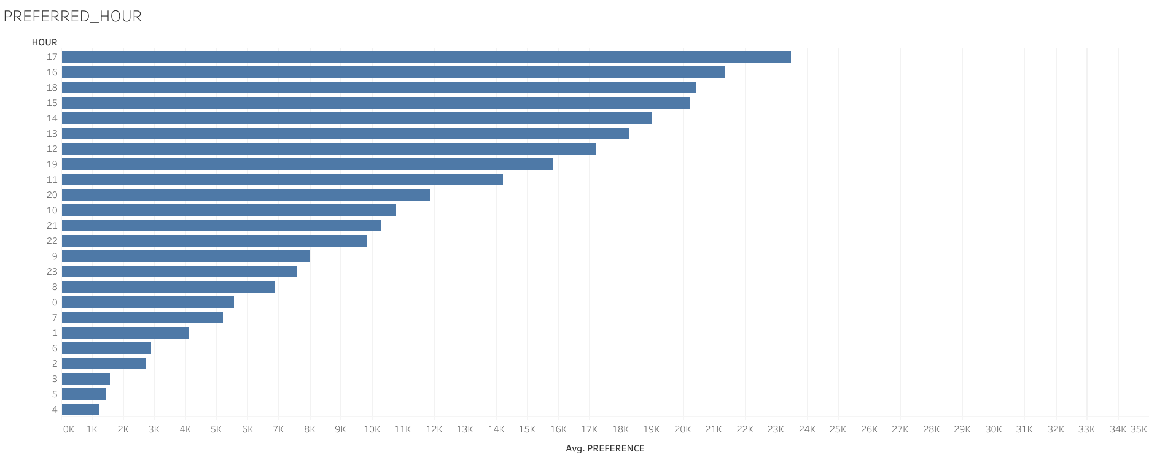
Preferred Hour for cycling-Fig 5

Slide 9
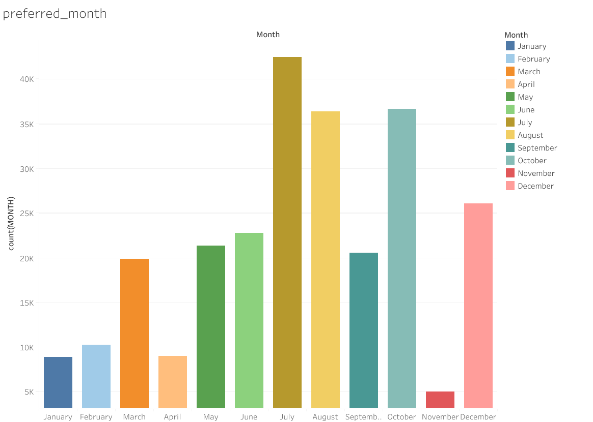
Preferred Month for cycling-Fig 6

Slide 10
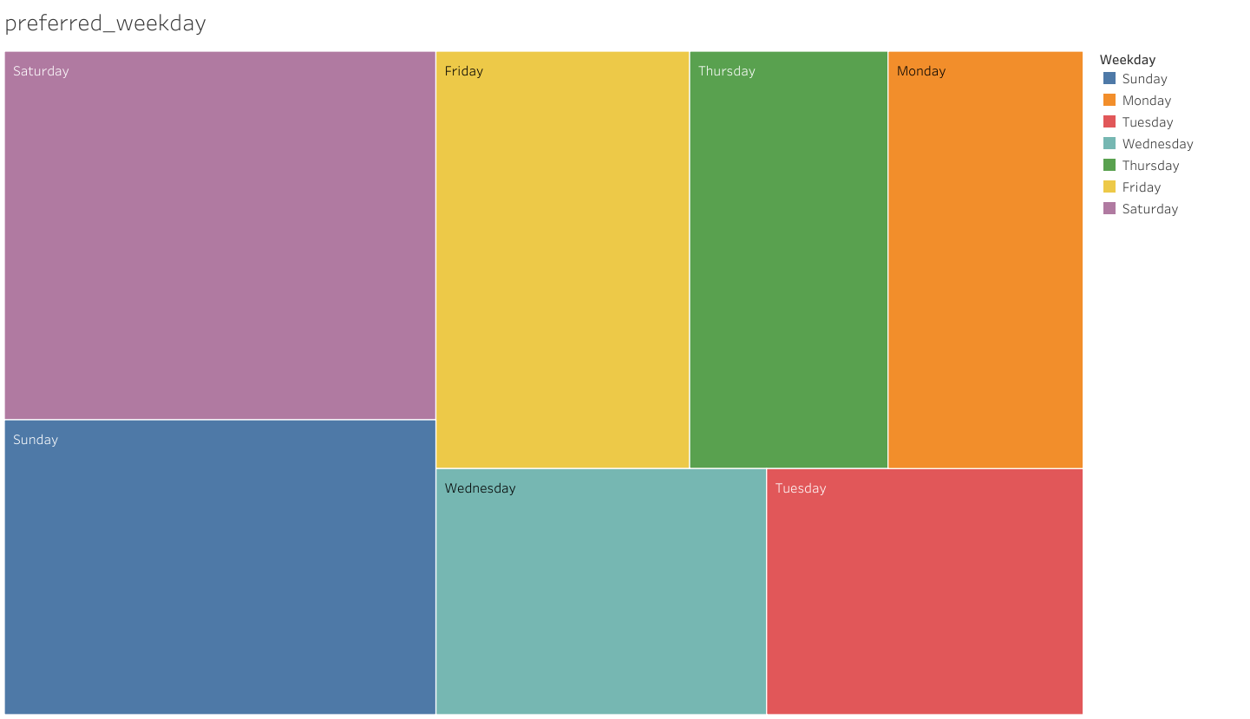
Preferred WEEKDAY for cycling-Fig 7

Slide 11
Recommendations
Cyclist can keep advertising their general programme to attract large riders. However, To convert casual members to annual members Following are the recommendations
From Fig 1 ,we can an insight about most preferrable bike among Casual Members.
From Fig 2-Popular End station ,Fig 3-Popular start station , Fig 4 Route preferrable. Cyclist can target the Riders of these locations with advertisement through emails, chats, Notification through app to join annual membership.
Also , cyclist in these popular stations ad route can conduct Healthy events, competitions and Get-together among both annual and casual members so that casual members can attract to annual membership

Slide 12
Recommendations
From fig 5-Most preferred Hour, We can get that Number of rides starts picking up from 2 PM ,reaching peak at 5 PM and 6PM in the evening and gradually slows down till 8 PM .Cyclist can conduct group rides, events and conduct session on importance of healthy lifestyle so that casual members get more attracted towards programme and eventually turned to annual membership.
*same ,recommendations Go for preferred weekdays where Cyclist can conduct Group rides, Family rides ,events on preferred weekdays. Can target segment of casual riders on FRIDAY,SATURDAY and SUNDAY through advertisement.

Slide 13
Recommendations
*Out of total casual riders,356 shows pure riding behaviour of Annual membership where marketing team can convince them to take annual subscription.
*Annual ,Half yearly events in July, august and September can be conducted where numbers of casual riders are high . To attract them. Events will be both for annual and casual .
*Special features of subscription to Annual members provided at those location where casual members rides are high can convert casual members.

Slide 14
Limitation of DATA/STUDY
The study has been conducted through data provided .However, There are some limitations to this study.
IF each rider’s unique id is provided ,The it would be easier to target riders on the basis of numbers of rides.
Subscription ship Fees if provided then , cost –benefit analysis can be done for some segment of Casual Riders .

Slide 15
Author Note
This is the first Study on DATA analytics that I have done .Study has been done to the best of my knowledge AND this study is open to Feedbacks among analytics community.
Happy Learning!!!!!!!
-SHUBHANKAR SHARMA

Slide 16
THE END
Done on-27-06-2022

